Slide 1
Safe Until It Isn't
Correlation spikes, portfolio fragility, and true diversification
Research question
Does diversification fail exactly when it is needed - during market stress?
Data Science in Finance seminar | Group 5 | July 2026
Andrea Saliola Bucelli | Florian | Timo
Source: reports/final_report.pdf
1
Notes:
Open with the exact research question from the report: whether diversification fails in market stress.
Frame the deck as diagnostic, not a portfolio-allocation recommendation.
Preview the central distinction: realized comovement can rise, but Forbes-Rigobon asks whether this is contagion or volatility-driven interdependence.

Slide 2
MOTIVATION
Diversification looks safer when calm and stress are averaged together
Mean-variance diversification depends on the covariance matrix. The problem is not diversification as an idea; it is treating one full-sample matrix as if it were stable across regimes.
The report's test
1. Estimate calm and stress regimes
2. Compare raw correlations
3. Bootstrap the changes
4. Test portfolio concentration with PCA
5. Apply Forbes-Rigobon adjustment
Full sample
Calm and crisis days are blended.
Stress regime
The same assets can collapse onto fewer independent directions.
Diagnostic goal
Separate experienced comovement from volatility-driven measurement bias.
Source: final_report.pdf, Sections 1 and 4
2
Notes:
Motivate the analysis with the report's portfolio-risk setup: covariance and correlation are central inputs.
A full-sample covariance matrix can understate joint risk if the conditional covariance matrix changes in stress.
Emphasize that the project does not build or backtest strategies; it diagnoses whether diversification is regime-dependent.
Bridge to the empirical design: identify regimes first, then condition every downstream statistic on those regimes.

Slide 3
DATA
Two ETF panels separate asset-class diversification from equity geography
Daily adjusted ETF log returns are evaluated on a common balanced window so correlations and PCA matrices are comparable across universes.
Panel A: cross-asset
Panel B: international equity
SPY, SHY, TLT, AGG, HYG, GLD, DBC, USO, VNQ
SPY, EFA, EEM, EWG, EWU, EWJ
U.S. equity, Treasury curve, aggregate and high-yield credit, gold, commodities, oil, and listed real estate.
U.S., developed ex-U.S., emerging-market, Germany, U.K., and Japan equity exposures.
12 Apr 2007 - 30 Dec 2025
2,443
2,268
48.1%
common return window
calm trading days
stress trading days
stress share
Source: final_report.pdf Section 3; src/settings/tickers.py; outputs/03_correlation_raw/correlation_summary.csv
3
Notes:
Panel A is deliberately cross-asset and parsimonious rather than exhaustive.
Panel B holds the asset class fixed as equities and varies geography.
The common balanced window starts after HYG enters, so all matrices are internally comparable and positive semidefinite.
Use the sample-size line to reassure the audience that Panel A, Panel B, and the combined universe are compared on the same days.

Slide 4
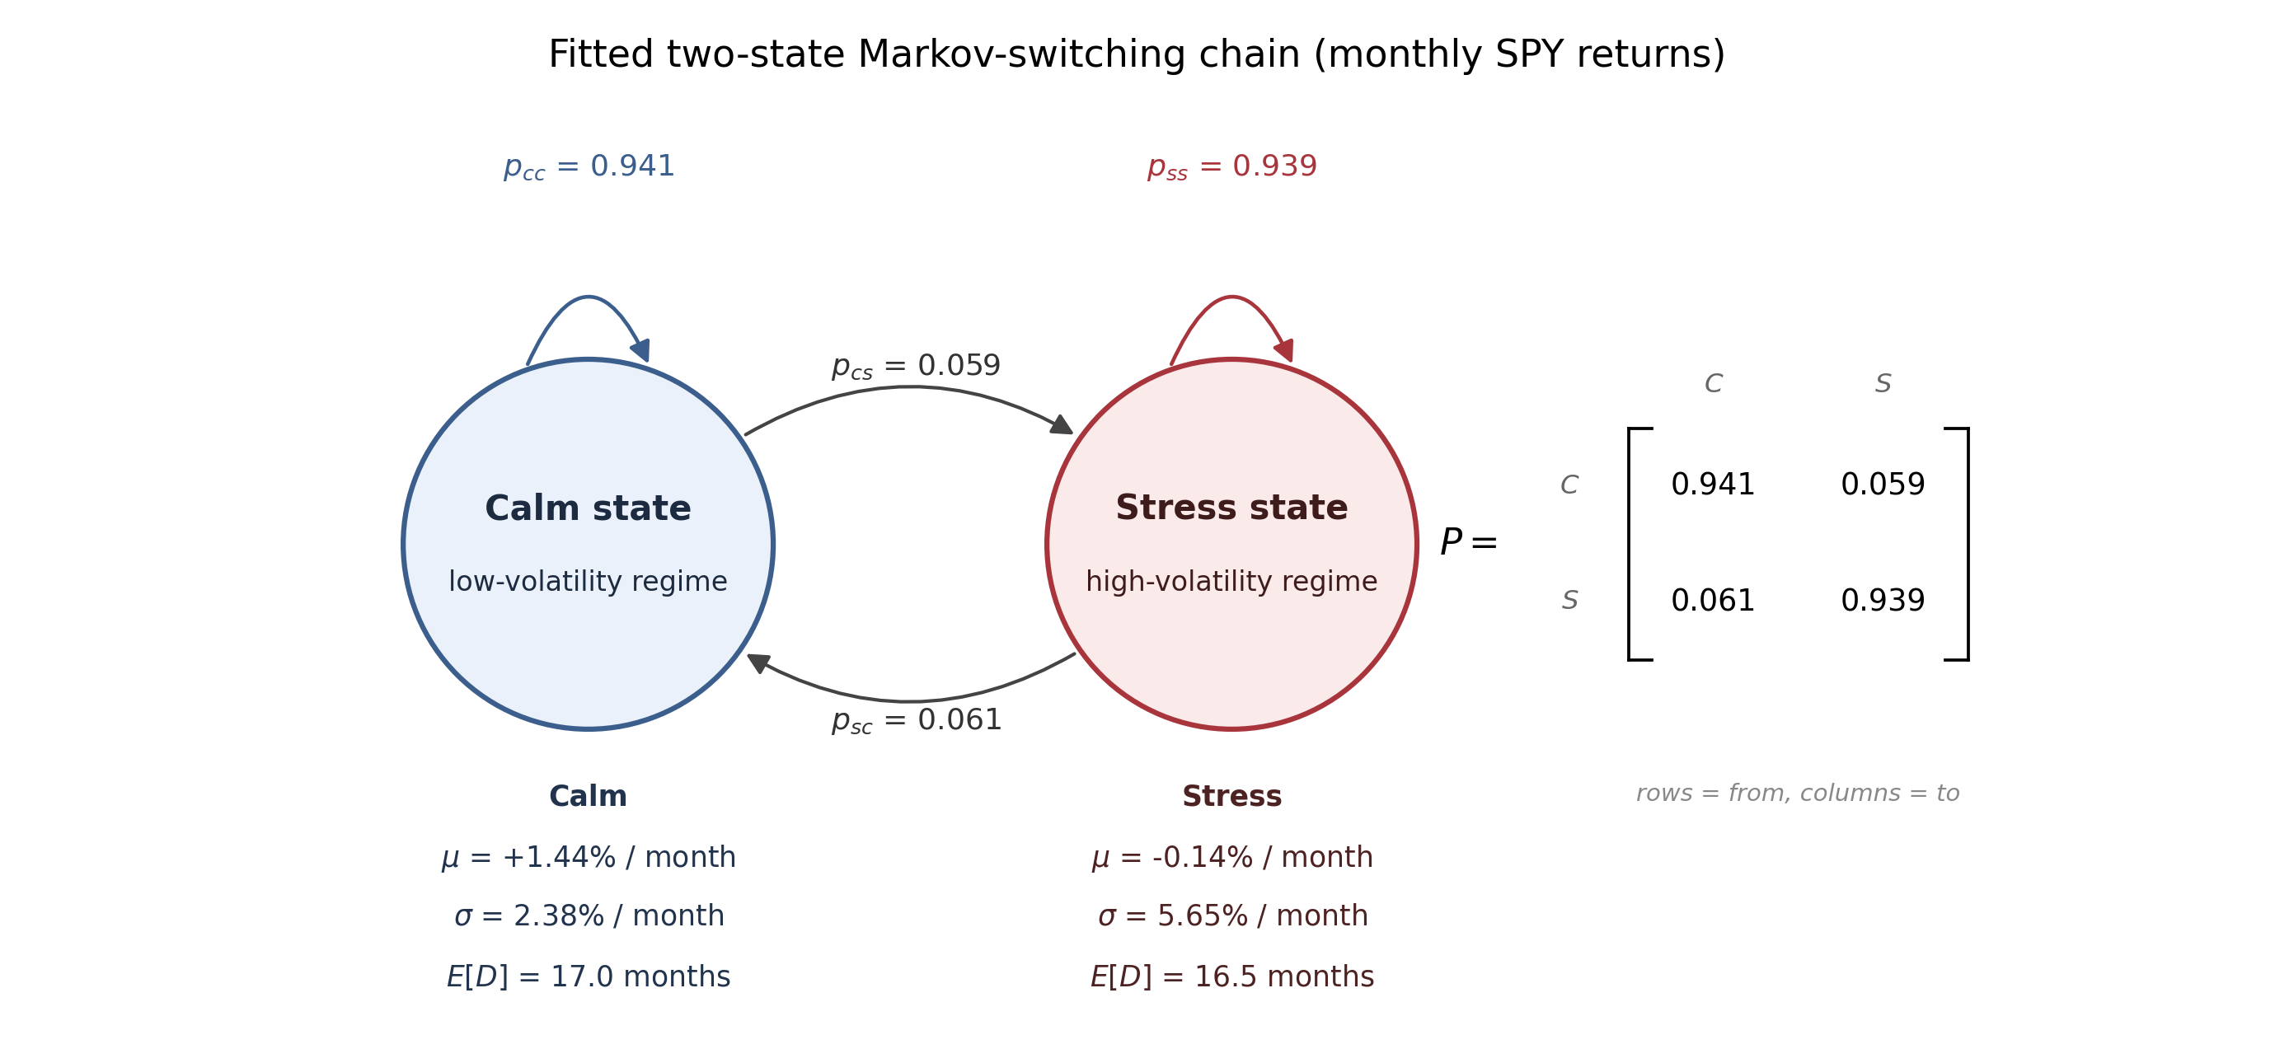
REGIME IDENTIFICATION
The official stress label is the high-variance Markov state
2.38% / month
calm volatility
5.65% / month
stress volatility
0.94
state persistence
- Two-state model on monthly SPY log returns.
- Both mean and variance switch across states.
- Stress is identified ex post as the higher-variance state.
Figure: outputs/02_regimes/markov_chain_diagram.png
4
Notes:
Explain the model in one sentence: monthly SPY returns are assigned to one of two latent states.
Stress is not named in advance; it is the fitted state with higher variance.
The transition matrix shows both states are persistent, so the model does not flicker daily.
Use the volatility contrast to justify why this is a stress regime.

Slide 5
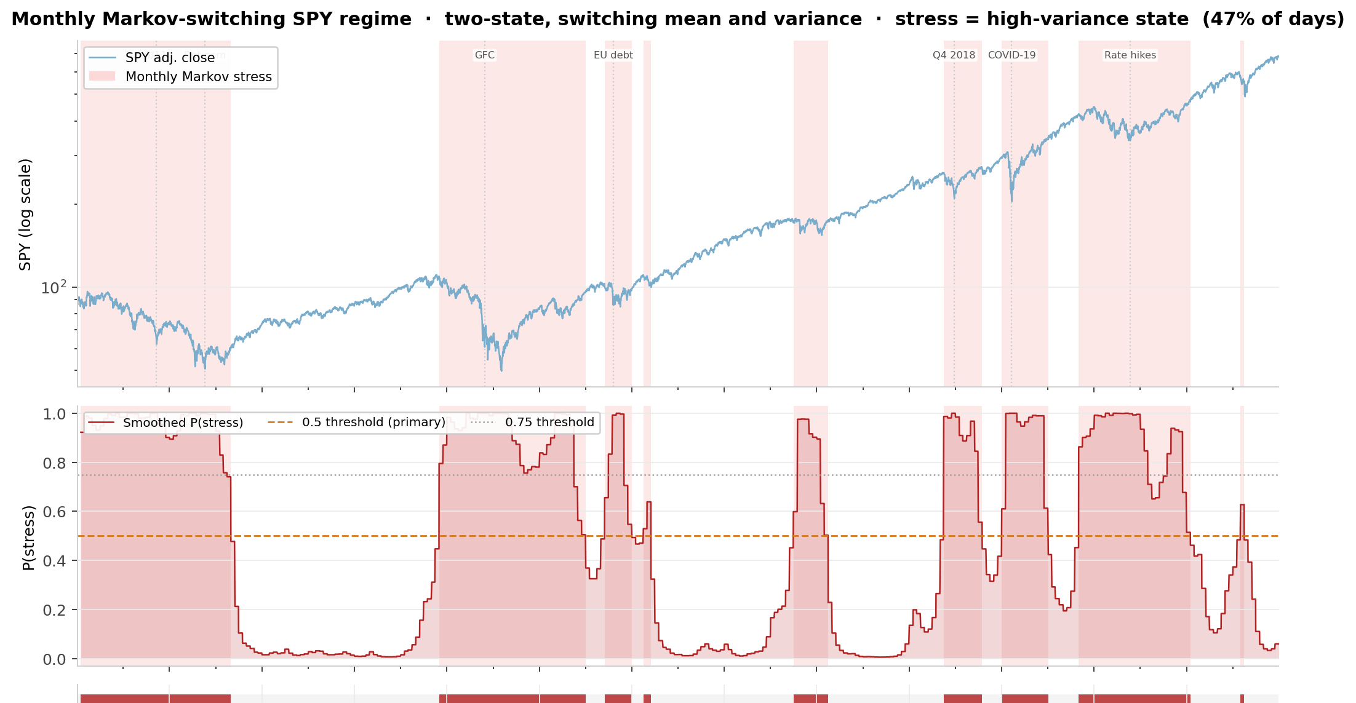
REGIME TIMELINE
The fitted stress state captures the major crisis episodes
The stress path includes the dot-com unwind, the GFC, euro-area stress, late-2018 selloff, COVID-19, and the 2022 rate-hike drawdown.
Figure: presentation/figures/regime_timeline_spy_probability.png (derived crop from outputs/02_regimes/markov_regime_monthly.png)
5
Notes:
Point out that the model was not given crisis dates; it identifies high-variance episodes from returns.
The top panel shows SPY with stress shading, and the middle panel shows smoothed stress probabilities.
The report validates the monthly regime against a rule-based VIX-plus-drawdown label and a weekly Markov re-estimation.
Do not overstate forecasting: these are smoothed ex-post probabilities used for historical regime conditioning.

Slide 6
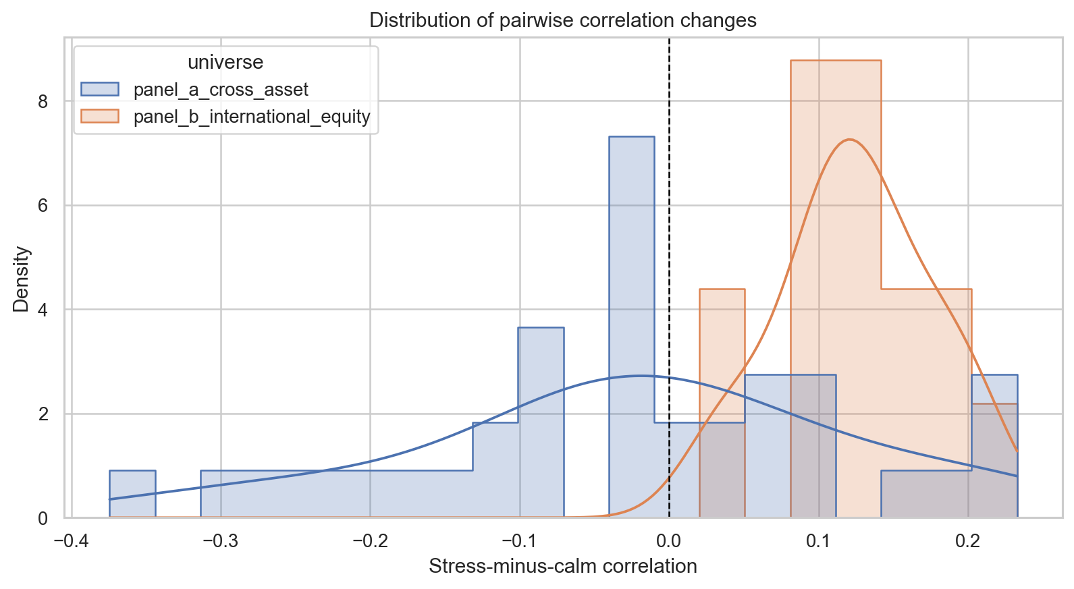
RAW CORRELATIONS
Equity geography tightens uniformly, while cross-asset risk reshuffles
Raw stress-minus-calm changes tell two different stories.
- Panel B: mean correlation rises 0.741 to 0.866; all 15 pairs increase.
- Panel A: mean correlation edges down 0.195 to 0.170, but the average hides offsetting moves.
- Risk-on real estate, equity, and commodity pairs tighten; Treasury and gold sleeves often decouple.
11 / 15
22 / 36
Panel B breakdown pairs
Panel A resilient pairs
Figure: outputs/03_correlation_raw/delta_corr_distribution.png; values from outputs/03_correlation_raw/*.csv
6
Notes:
Define delta rho as stress correlation minus calm correlation.
Panel B lies entirely to the right of zero, so geographic equity diversification weakens uniformly.
Panel A is not a textbook all-correlations-rise story; the average is near zero because risk-on tightening is offset by safe-haven decoupling.
Use the pair classes carefully: raw breakdown is descriptive and still needs uncertainty and Forbes-Rigobon checks.

Slide 7
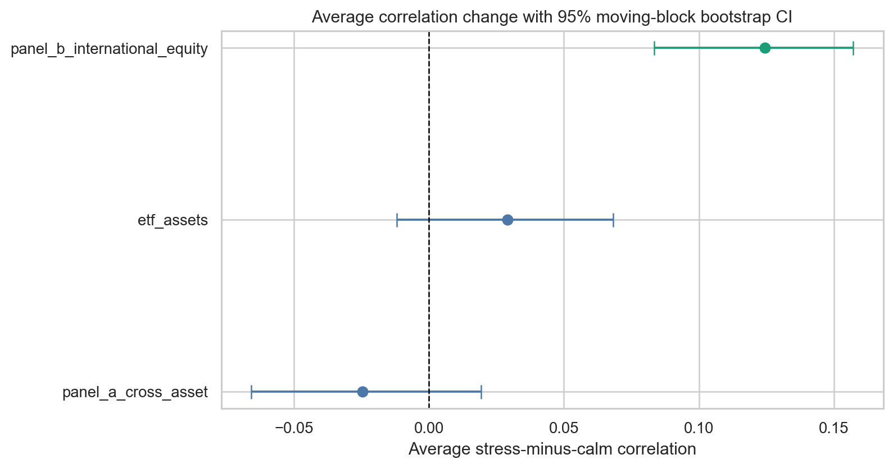
BOOTSTRAP INFERENCE
Only the international-equity average survives uncertainty
Block bootstrap result
- Panel B average delta rho = +0.124, 95% CI [+0.084, +0.157], p < 0.001.
- Panel A and combined universe averages have confidence intervals crossing zero.
- A null average is not no effect: Panel A has significant increases and decreases that cancel.
- The block bootstrap is more conservative than Fisher-z because daily returns are dependent.
11
15
Panel A FDR pairs
Panel B FDR pairs
Figure: outputs/04_correlation_bootstrapping/universe_average_delta_ci.png; values from outputs/04_correlation_bootstrapping/*.csv
7
Notes:
Mention the circular moving-block bootstrap: whole cross-sectional rows and regime labels are resampled in 21-day blocks.
Panel B is the only universe with an average effect unambiguously above zero.
Panel A's average is statistically flat, but its pair-level reshuffle is real: 6 significant increases and 8 significant decreases at 95%, with 11 FDR pairs.
This slide is about uncertainty, not the economic mechanism; the mechanism comes next through PCA and Forbes-Rigobon.

Slide 8
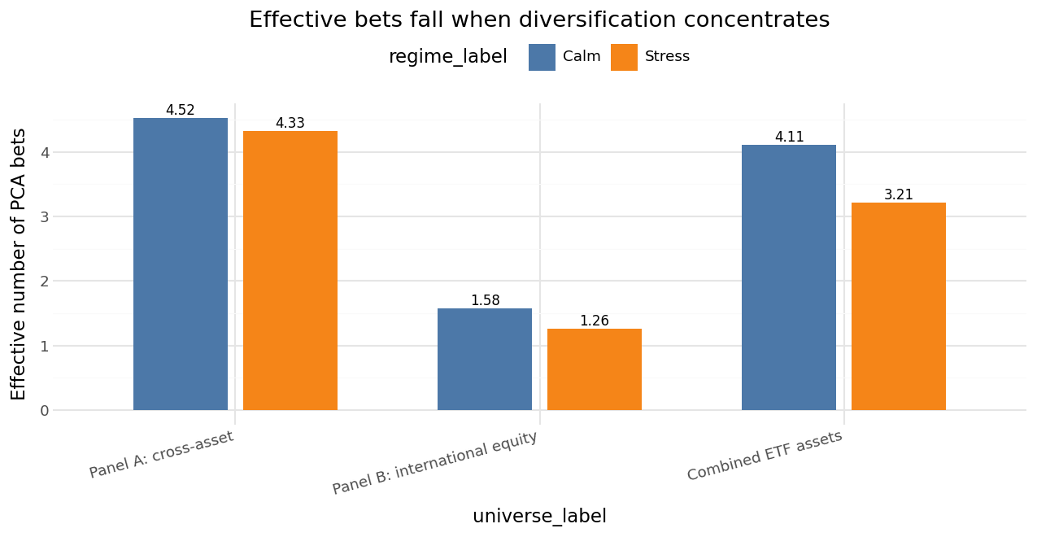
PCA CONCENTRATION
Stress leaves fewer effective bets in every universe
Portfolio-level concentration reinforces the pairwise result.
- PC1 share rises in all three universes.
- Effective bets fall from 4.52 to 4.33 in Panel A.
- Panel B is nearly one-factor in stress: 1.58 to 1.26 effective bets.
- The combined universe loses almost one full effective bet.
-0.90
88.9%
combined effective-bet loss
Panel B stress PC1
Figure: outputs/05_pca/effective_bets_calm_vs_stress.png; values from outputs/05_pca/*.csv
8
Notes:
Explain effective bets as an eigenvalue-based measure of how many independent directions remain.
Every universe satisfies the report's concentration verdict: PC1 share rises and effective bets fall.
Panel A's PCA result is important because diversification erodes at the portfolio level even though its average pairwise correlation does not rise.
Panel B is the starkest case: the global equity factor becomes almost the only direction in stress.

Slide 9
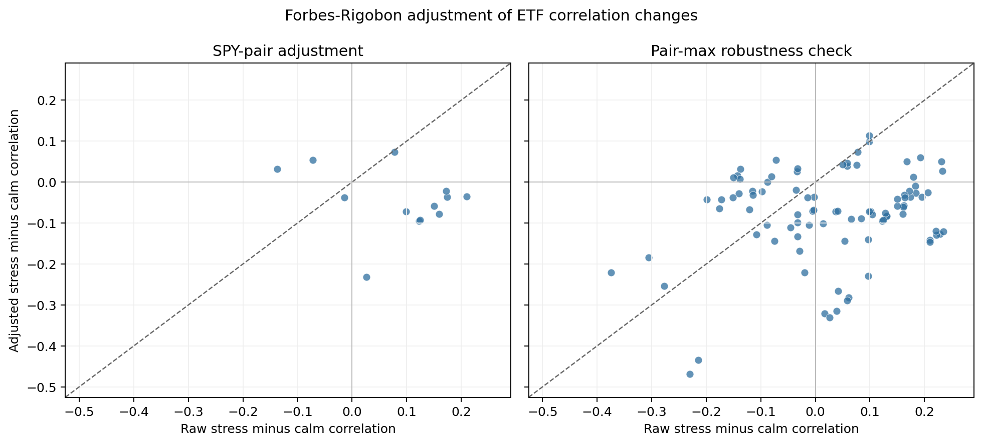
ADJUSTED CORRELATIONS
Forbes-Rigobon reframes breakdown as volatility-driven interdependence
The adjustment asks why correlations rose, not whether investors experienced higher comovement.
- Raw correlations are the realized stress-period comovement.
- Forbes-Rigobon deflates stress correlations for higher variance of the common shock.
- No pair survives as a robust breakdown under either adjustment method.
- The experienced breakdown is real; the source is heteroskedasticity rather than structural contagion.
0
2.97
robust breakdowns
SPY variance shock
Figure: outputs/06_adjusted_correlation/forbes_rigobon_raw_vs_adjusted.png; values from outputs/06_adjusted_correlation/*.csv
9
Notes:
Be explicit that Forbes-Rigobon complements rather than overturns raw correlations.
Raw correlations remain what a portfolio holder experiences in stress.
The adjustment asks whether the dependence relationship changed after accounting for the higher volatility state.
The report's headline is no robust contagion-style breakdown, but heightened volatility-driven interdependence.

Slide 10
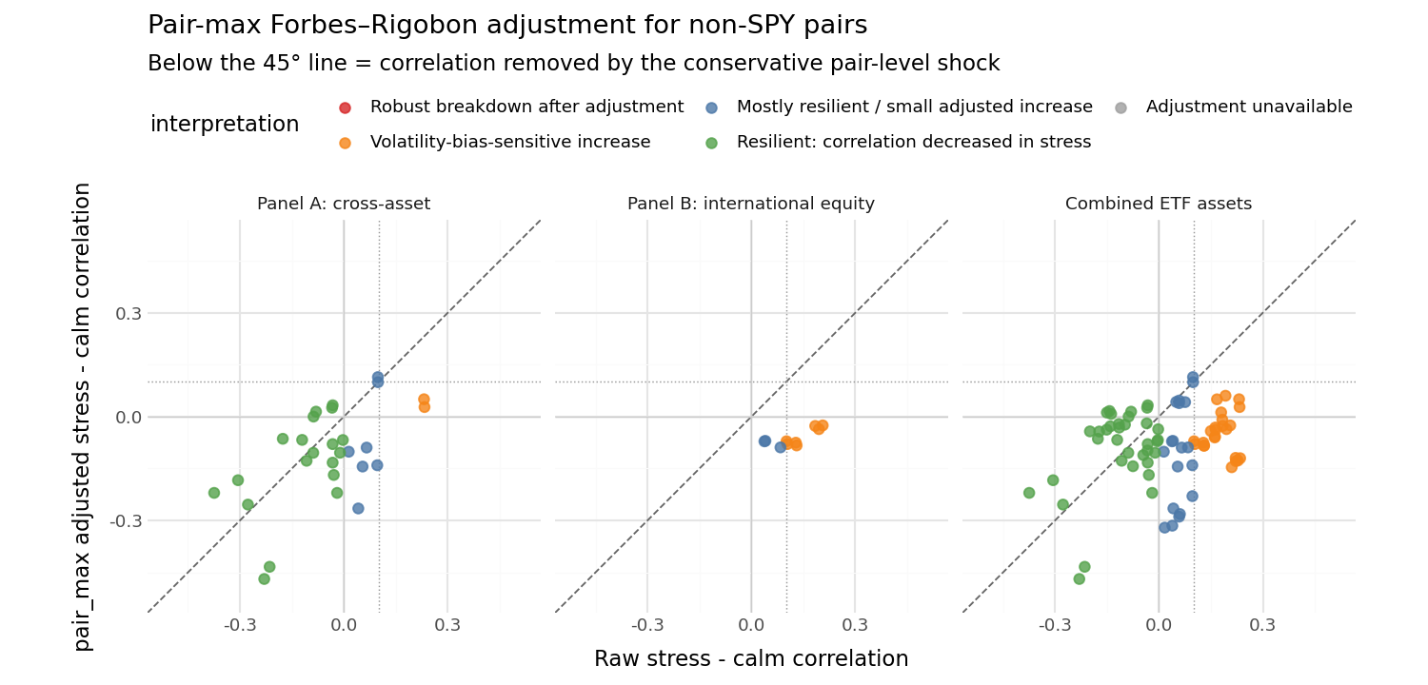
NUANCE
The equity block supplies fragility; cross-asset hedges stay resilient
The conservative non-SPY pair-max view separates the two panels sharply.
- Panel A non-SPY pairs are dominated by resilient decreases.
- Panel B has no resilient non-SPY pair.
- Treasuries and gold keep diversifying in stress on average.
- Listed real estate behaves more like the risk-on block than like a separate hedge.
19 / 28
0 / 10
Panel A non-SPY resilient
Panel B non-SPY resilient
Figure: outputs/06_adjusted_correlation/forbes_rigobon_pair_max_non_spy_raw_vs_adjusted.png; values from outputs/06_adjusted_correlation/forbes_rigobon_pair_max_non_spy_pairs.csv
10
Notes:
This is the optional nuance slide, but it uses implemented Forbes-Rigobon outputs rather than adding new stress-type analysis.
The report mentions 2022 as one identified stress episode, but there is no separate implemented 2022 stock-bond hedge-flip analysis in the active outputs.
Stress the asymmetry: international equity tightening is not structurally robust after adjustment, while many cross-asset hedges actually decouple.
Keep the portfolio-management implication qualitative: stress-robust diversification needs different risk drivers, not merely more countries.

Slide 11
DEMO PREVIEW
Dashboard is a supplement, not a source of new evidence
TODO: add Streamlit dashboard screenshot once the app exists in the repo
Current repository scan found notebooks, scripts, report files, and generated outputs, but no Streamlit app entry point or pages directory.
- Keep any dashboard as an exploration layer for regimes, pair rankings, PCA, and adjusted correlations.
- Do not present dashboard interactions as additional empirical results.
- Replace this placeholder with real app pages or screenshots after implementation.
0
report + outputs
Streamlit files found
main evidence source
Source: repo scan; TODO missing dashboard screenshot
11
Notes:
This slide is intentionally marked TODO because no Streamlit dashboard files were found in the active repo.
If the team adds a dashboard, position it as a supplement for exploring the already-generated outputs.
Possible app pages should mirror existing artifacts: regime timeline, correlation pairs, bootstrap inference, PCA concentration, and Forbes-Rigobon adjustment.
Do not invent screenshots or dashboard results for the seminar.

Slide 12
CONCLUSION
Diversification must be tested in the stress regime, not only on average
Equities are fragile
International equity correlations tighten uniformly, and Panel B collapses toward one effective bet in stress.
Cross-asset hedges are more resilient
Treasuries and gold often decouple further, even though risk-on sleeves such as VNQ, commodities, oil, and equities tighten.
Raw and adjusted results answer different questions
Raw correlations measure experienced comovement; Forbes-Rigobon shows the increase is volatility-driven interdependence, not robust contagion.
Bottom line: more assets or more countries are not enough. The question is whether the risk drivers remain distinct when the stress state arrives.
Source: final_report.pdf, Sections 6-7
12
Notes:
Close by answering the opening question with the report's qualified answer: diversification weakens in stress, but not all sleeves fail equally.
Equity geography is fragile; cross-asset hedges are resilient on average.
Avoid overclaiming: these are diagnostics, not direct allocation rules.
End with the method implication: stress-regime testing should be part of diversification assessment.

